Slide 1
What makes a Good QA?
Pratik Tuladhar
QA
Ekbana Solutions

Slide 2
What is QA?
Quality assurance (QA) is a way of preventing mistakes or defects in manufactured products and avoiding problems when delivering solutions or services to customers; which ISO 9000 defines as "part of quality management focused on providing confidence that quality requirements will be fulfilled“ (ISO 9000:2005, Clause 3.2.11).
A software quality analyst is responsible for applying the principles and practices of software quality assurance throughout the software development life cycle. Though often referred to as "quality assurance", software testing is considered to be only one part of the larger process of reducing errors. (http://wiki.c2.com/?QaIsNotQc)

Slide 3
QA & QC and the blurred line.
Quality Assurance makes sure you are doing the right things, the right way.
Quality Control makes sure the results of what you've done are what you expected.

Slide 4

What are the expectations from a QA?

Slide 5
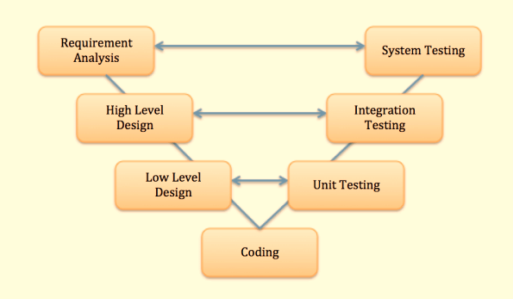
So does make a good QA?
You need to have some great development skills

Slide 6
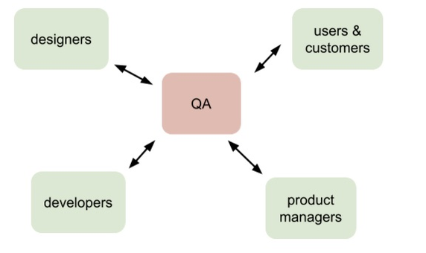
So does make a good QA?
You need to be good at communication

Slide 7
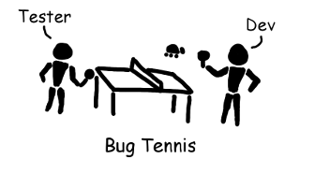
So does make a good QA?
You need to be diplomatic

Slide 8
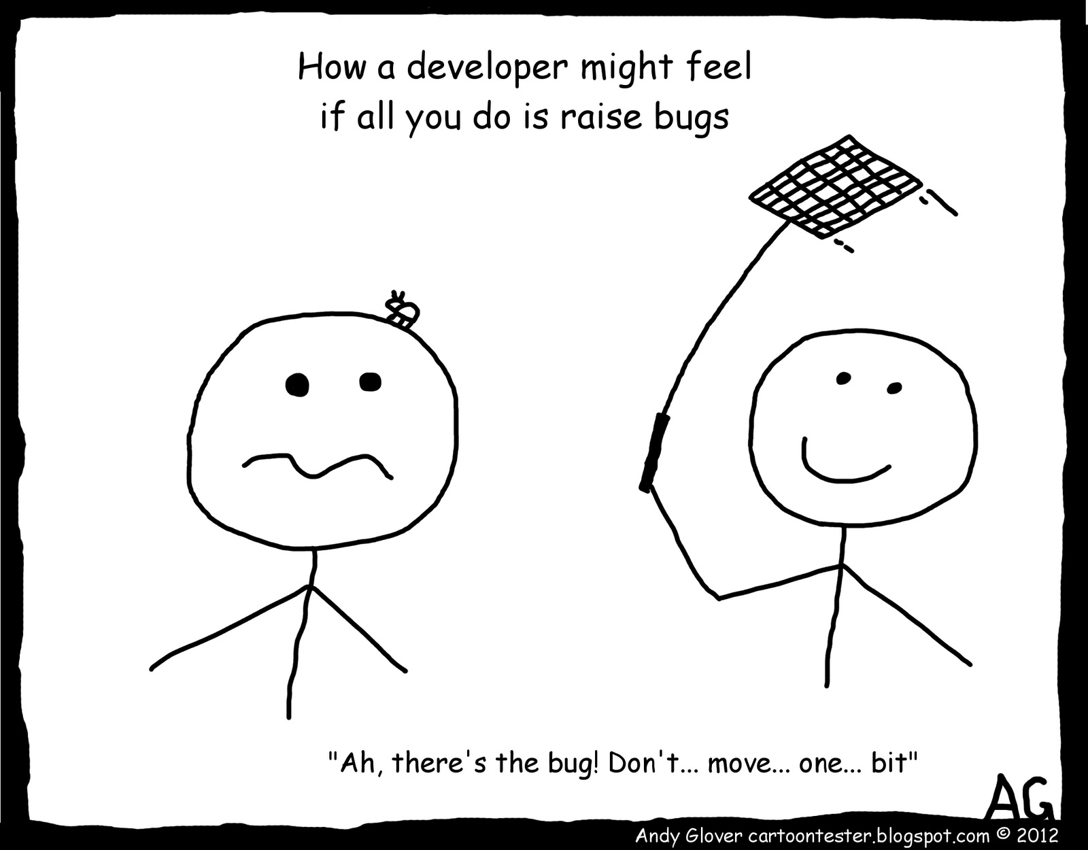
So does make a good QA?
You need to be a good negotiator

Slide 9
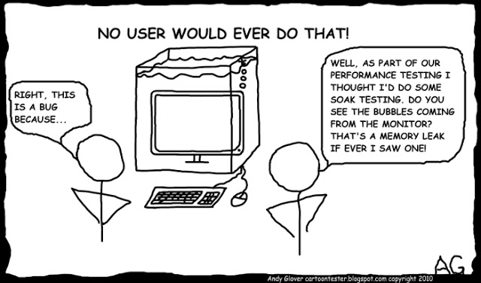
So does make a good QA?
You have to be good at testing

Slide 10
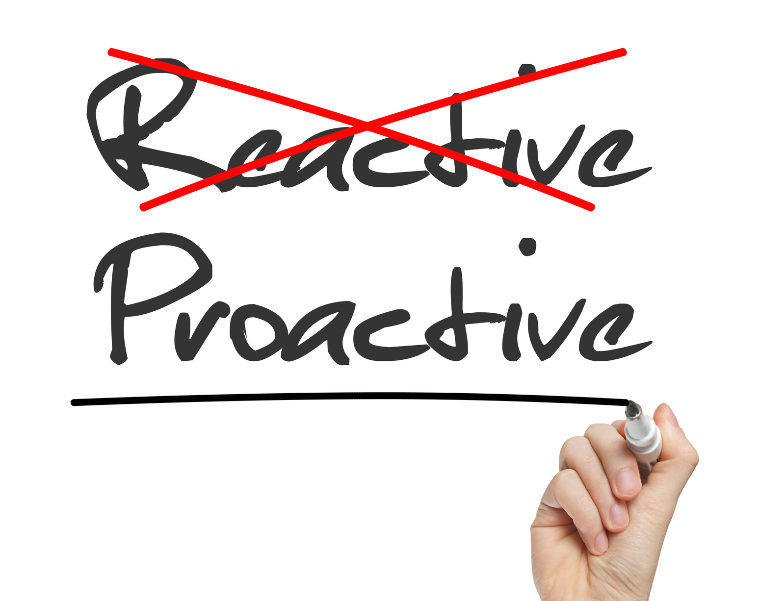
So does make a good QA?
You need to be proactive

Slide 11
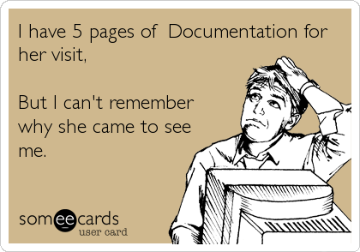
So does make a good QA?
You need to be good at documentation

Slide 12
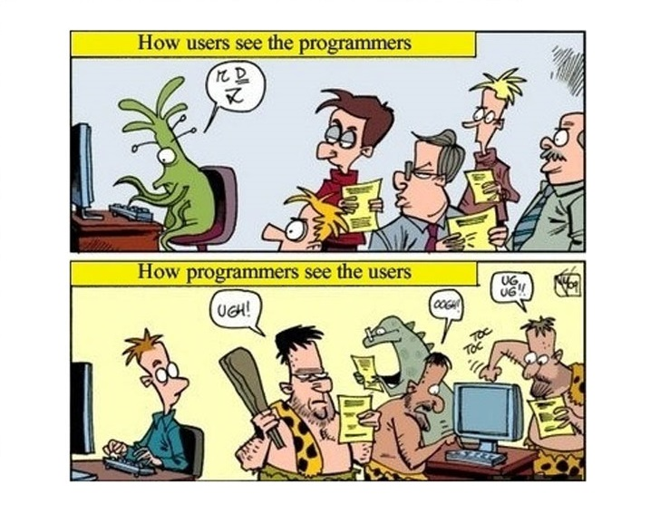
So does make a good QA?
You need to understand your product from your end-users perspective

Slide 13
Conclusion
QA need to be a versatile member of the team who validates the application from the end user’s perspective.
They need to be aware of the architecture the application is being built in.
They need to be good at testing to identify the bugs.
They need to document the tasks they have performed.
They need to be very proactive and report the issues that might not be in their scope.
They need to be diplomatic and a good negotiator.
They need to be very good at communication.

